Slide 1





clinic management system

Slide 2


Team names
Sohair Ashraf | 221001867
menna mosed | 221001273
Nermeen Hanea Ali | 221002201
mohammed sayed | 231002190

Slide 3

Business Rules
1) Department-Clinic
Each clinic belongs to only one Department.
Each Department can have Multiple Clinics.
Participation: Mandatory on both sides.
Explanation: Every Department must be associated with at least one clinic, a clinic must be associated with one department

Slide 4
Business Rules
(2)Doctors-Department
Each Department has many Doctors.
Each Doctor works in one Department.
Participation: optional on the Department side and Mandatory on the Doctor Side.
Explanation: A Department may have multiple Doctors working under it, but a department can have no Doctors For example: if it is a new Department yet to hire Staff.

Slide 5
Business Rules
(3) Appointment-Doctor
Each Appointment is associated with exactly one doctor To Treat the Patient.
Each Doctor Can Have Multiple appointments with Different Patients.
Participation: Mandatory For Doctor and Appointment
Explanation: Every doctor must have appointments Scheduled, but An appointment Cannot exist without being associated with a doctor.

Slide 6
Business Rules
(4)Patient-Appointment
Each Appointment is associated with exactly one Patient
Each Patient can have Multiple appointments over time
Participation: Mandatory For Patient and Appointment
Explanation: Every appointment must be associated with a Patient, and each Patient can have only one appointment at a time

Slide 7
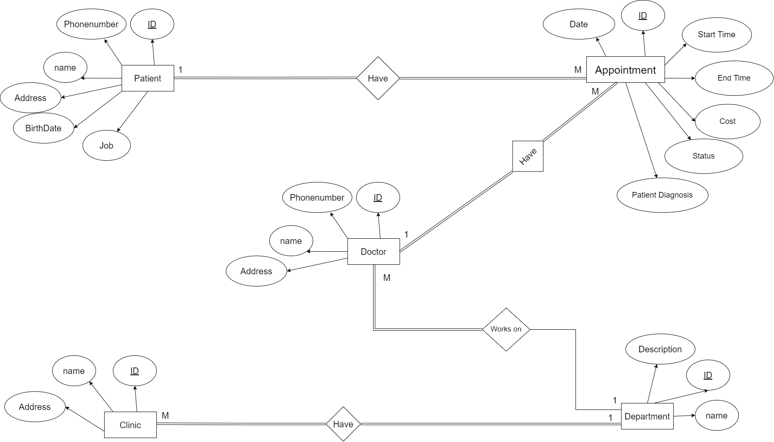
ERD Diagram

Slide 8
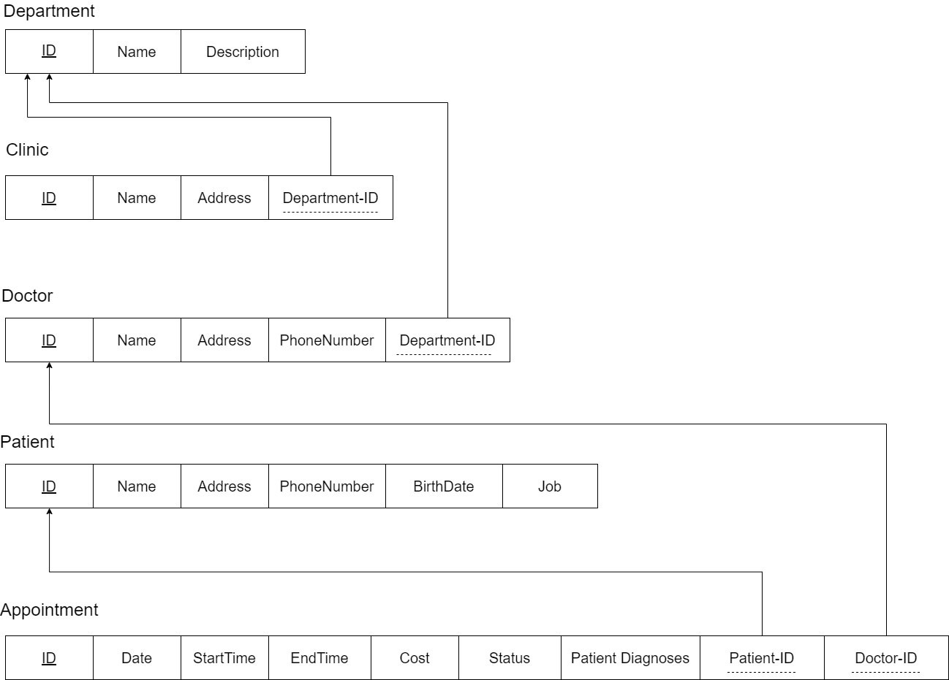
Relational schema

Slide 9
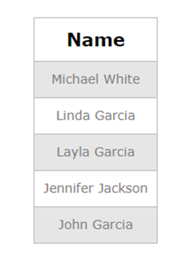
Queries
SELECT Patient. Name
FROM Patient
JOIN Appointment ON Patient.ID = Appointment.Patient_ID
WHERE Appointment.Patient_Diagnosis = 'Fatty Liver'
AND Appointment.Date >= DATE_SUB(CURDATE(), INTERVAL 1 YEAR);

Slide 10
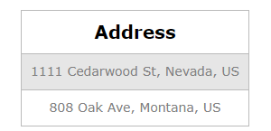
Queries
SELECT Clinic.Address
FROM Clinic
JOIN Department ON Clinic.Department_ID = Department. ID
WHERE Department.Name = 'Cardiology';

Slide 11
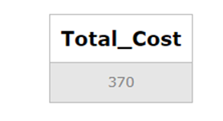
Queries
SELECT SUM(Appointment.Cost) AS Total_Cost
FROM Appointment
WHERE Appointment.Patient_ID = 12527
AND Appointment.Date >= DATE_SUB(CURDATE(), INTERVAL 3 YEAR);

Slide 12
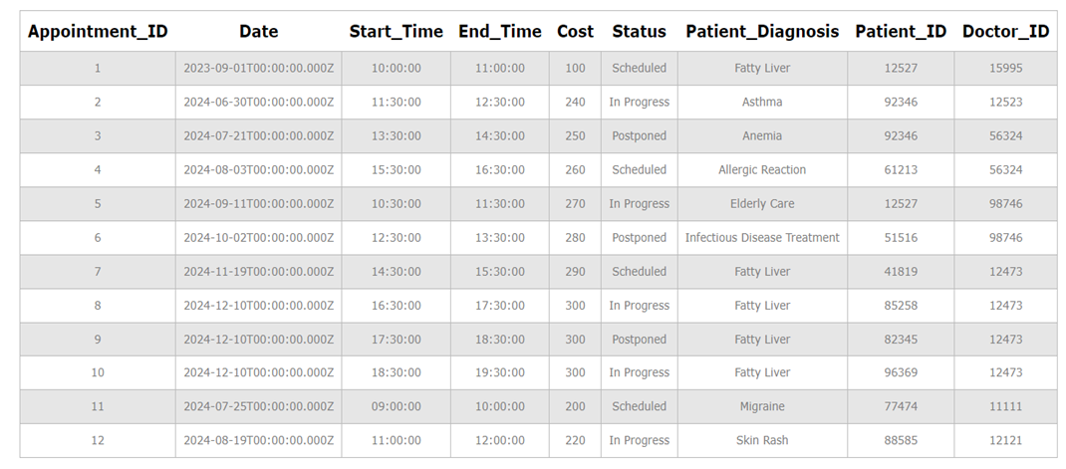
Queries
select *
from Appointment;

Slide 13
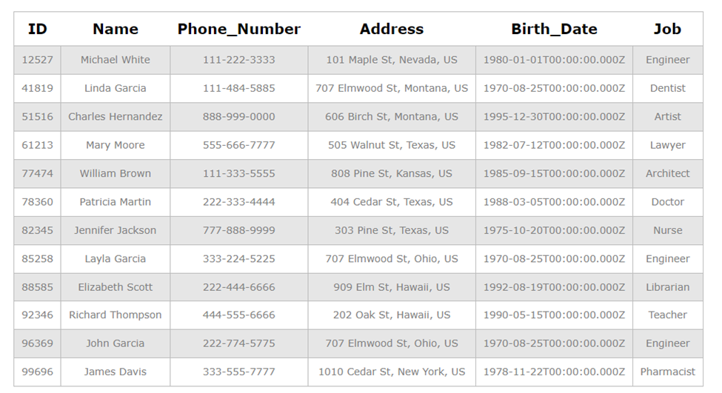
Queries
SELECT *
from Patient;

Slide 14
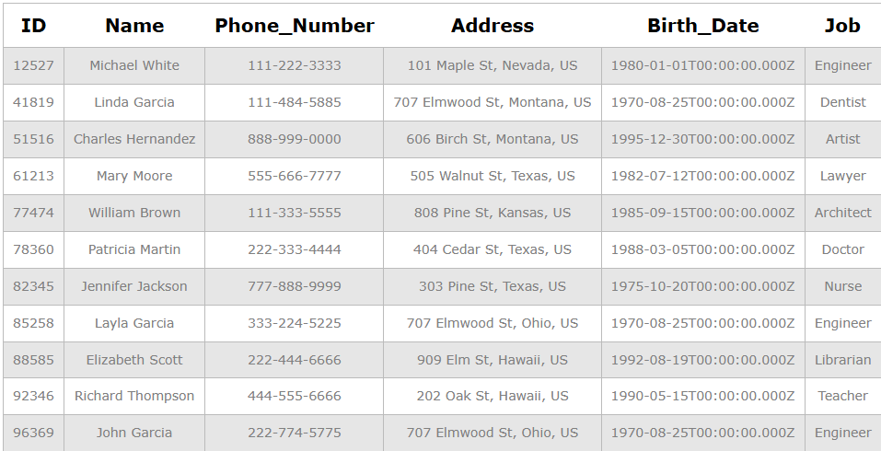
Queries
delete from patient
where id =99696

Slide 15
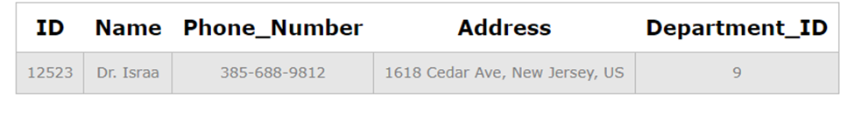
Queries
select *
from Doctor
where name='Dr. Israa';

Slide 16
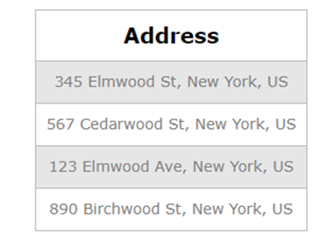
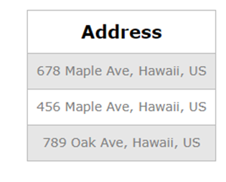
Queries
SELECT Address
FROM Doctor
WHERE Address LIKE '% New York, US';
SELECT Address
FROM Doctor
WHERE Address LIKE '% Hawaii, %';

Slide 17
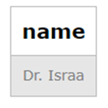
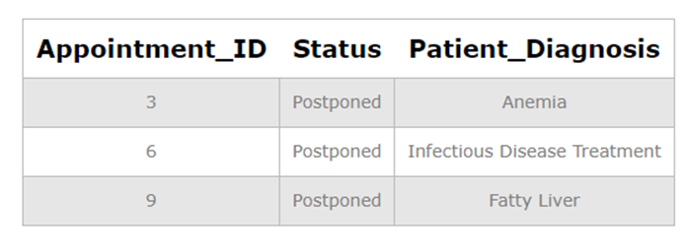
Queries
SELECT Doctor. name
FROM Doctor
JOIN Department ON Doctor.Department_ID = Department.ID
WHERE Department.ID = 9;
select Appointment_ID,Status,Patient_Diagnosis
from Appointment
where Status='Postponed';

Slide 18
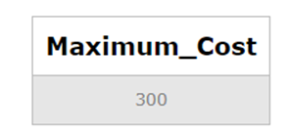
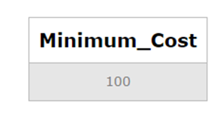
Queries
SELECT Max(Cost) As Maximum_Cost
from Appointment;
SELECT Min(Cost) Minimum_Cost
from Appointment;

Slide 19
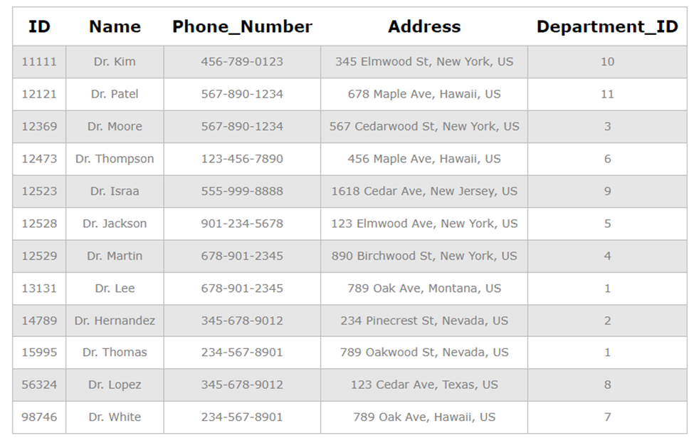
Queries
UPDATE Doctor
SET Phone_Number = '555-999-8888'
WHERE ID = 12523;
select *
from Doctor;

Slide 20
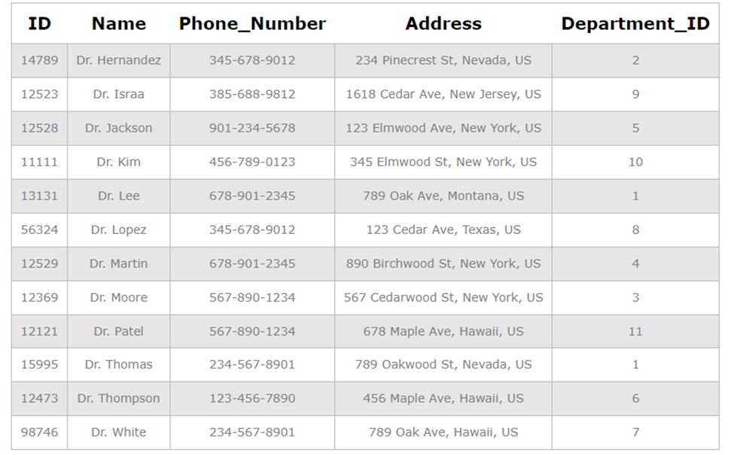
Queries
select *
from Doctor
order by name asc;

Slide 21
Thank You!

